Slide 1
Influence of Travel Ban Intervention on Covid-19 Spread in Wisconsin
Boyu Shen, Detao Yu

Slide 2
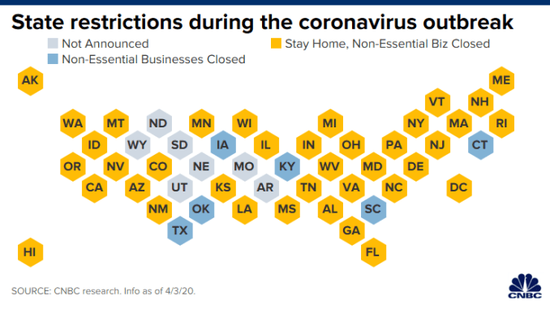
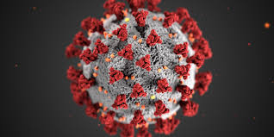
Introduction
COVID-19 continues to spread and affect many parts of the U.S. and the rest of the world. It is the best time to act in ways that slow the spread. Human mobility patterns and changes could be one indicator for understanding this virus.Our project is going to detect infected cases in each county in Wisconsin, analyze the infected cases distribution after implementation of travel ban and “stay at home” policy, we want to explore how human mobility changes influence Covid-19 spread.
We will consider various factors including population density and other mobility factors.
Grocery & pharmacy
Parks
Transit stations
Retail & recreation
Residential
Workplaces

Slide 3
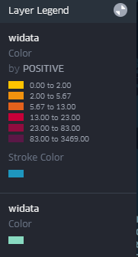
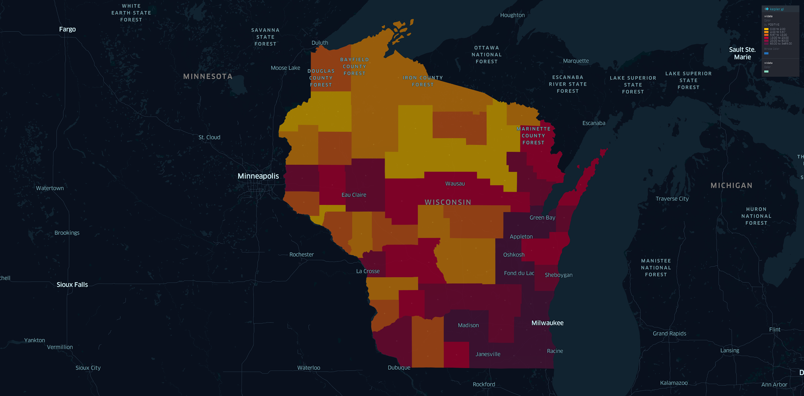
Outbreaks in Wisconsin of COVID-19 (Coronavirus Disease 2019)

Slide 4
Data
There are four base datasets needed for completing this project. Google COVID-19 Community Mobility Reports provides human mobility percent changes.
Coronavirus Locations: COVID-19 Map by County and State provides a base data set that include population for each county in Wisconsin.
COVID-19 Historical Data Table gives us information about the number of confirmed case in each.
We also use google shape file for counties in Wisconsin to get the geographic information.
Finally we merge all of the above data to form a single data frame and removed NaN values.

Slide 5
Method
We used both supervised and unsupervised methods:
Spatial Clustering: Apply K-Medoid Clustering method to classify 71 counties in Wisconsin into three clusters
For each cluster, find the best model of a multiple linear regression in Rstudio to regress the number of confirmed cases in each county on percent change in human mobility of different places and population density
We will apply Time Space Analysis using Kepler.gl to analyse the flights changes over time from January to April

Slide 6
Results and Findings

Slide 7
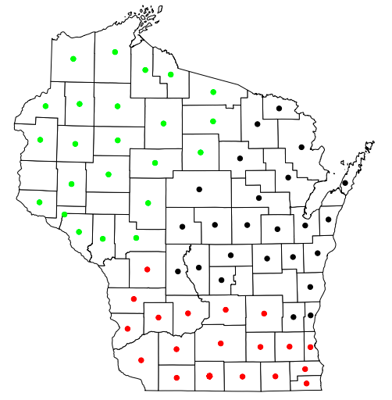
Apply K-Medoid Clustering method to form cluster of Counties :
Features used:
Number of Confirmed cases
Geographical coordinates

Slide 8
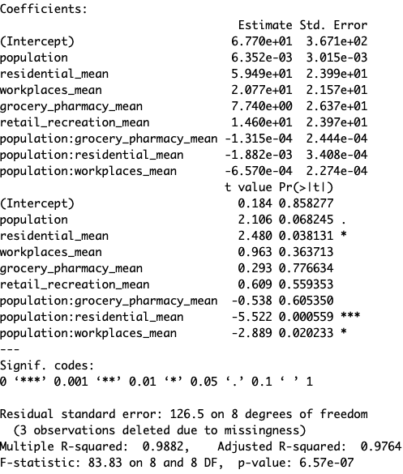
Multiple Linear Regressions for Different Clusters
1. Model for Southern counties(red points):
All variables are numerical and continuous
Confirmed cases =67.70+ 6.352*10^-3*pop + 59.49*residen + 20.77*work
+ 7.740*gro_ph + 14.6*retail
+ -1.315*10^-4*population *grocery_pharmacy_mean
+ -1.882*10^-3*population * residential_mean
+ -6.57*10^-4*population * Workplaces_mean
Pop- county population
Residen- mean value of percent mobility change for residence place
Work-mean value of percent mobility change for workplace
Gro_ph -Mean value of percent mobility change for grocery store and pharmacy
Retail - mean value of percent mobility change for retail and recreation

Slide 9
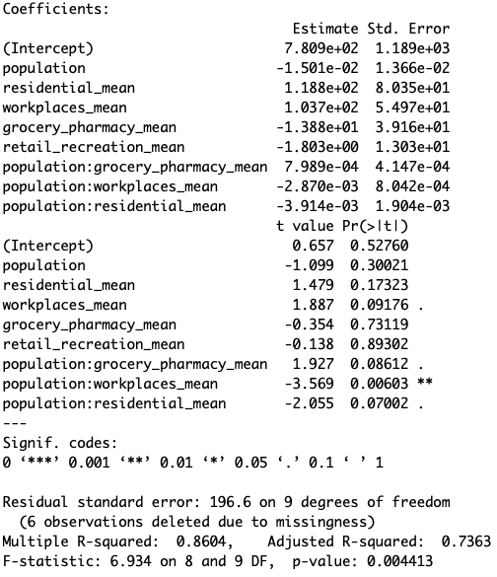
Multiple Linear Regressions for Different Clusters
2. Model for Northwestern counties(green points):
All variables are numerical and continuous
Confirmed cases =780.9+ -1.501*10^-2*population + 1.188*10^2residential_mean + 1.037*10^2*workplaces_mean + -13.88grocery_pharmacy_mean + -1.803retail_recreation_mean + 7.989*10^-4*population *grocery_pharmacy_mean + -3.914*10^-3*population * residential_mean + -2.870*10^-3*population * workplaces_mean

Slide 10
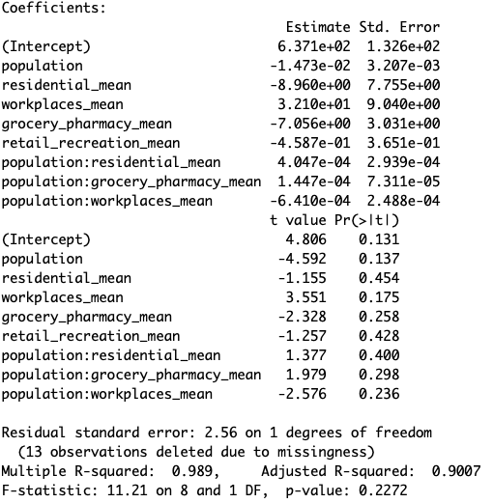
3 Model for Northeastern counties(black points):
All variables are numerical and continuous
Confirmed cases =637.1+ -1.473*10^-2*population + -8.96*residential_mean + 32.1*workplaces_mean + -7.056*grocery_pharmacy_mean + -4.587*10^-1*retail_recreation_mean + 1.447*10^-4*population *grocery_pharmacy_mean + 4.047*10^-4*population * residential_mean + -6.41*10^-4*population *
workplaces_mean

Slide 11
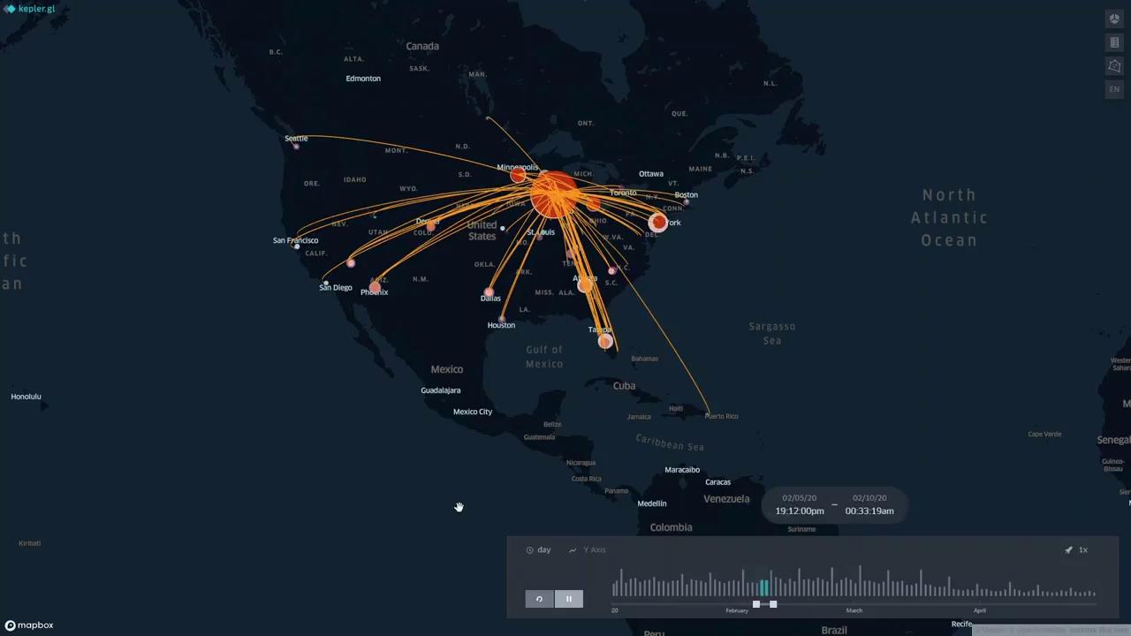
Time Playback: Flight changes of all airports in Wisconsin (January - April)

Slide 12
Conclusion
The travel ban policy have an important impact on the spread of coronavirus, this policy restricted on people’s travels, reduced the mobility, therefore cut off the opportunity of spread of the virus.
Mobility trends for retail, recreation, grocery, pharmacy, and workplaces and dropped a lot compared to the baseline, which means that governments’ travel ban and “stay at home” policies have prevented people from going out to those places for recreation or travelling.

Slide 13
Reference
Google COVID-19 Community Mobility Reports
COVID-19 United States Cases by County
WiDNR Open Data
COVID-19: County Data
Coronavirus Locations: COVID-19 Map by County and State
Crowdsourced air traffic data from The OpenSky Network 2020
The effect of travel restrictions on the spread of the 2019 novel coronavirus (COVID-19) outbreak
COVID-19 Historical Data Table

